Slide 1
Assignment
Read the article in the following link
https://www.baogiaothong.vn/tp-thu-duc-co-16-tuyen-duong-ngap-do-mua-khu-vuc-nang-nhat-ngap-toi-06m-192240516182450327.htm
Task: Summarize a causal argument made by Thủ Đức city’s authorities about the local flooding on May 15, 2024 and diagram the argument. Use clear premise and conclusion indicators.

Slide 2
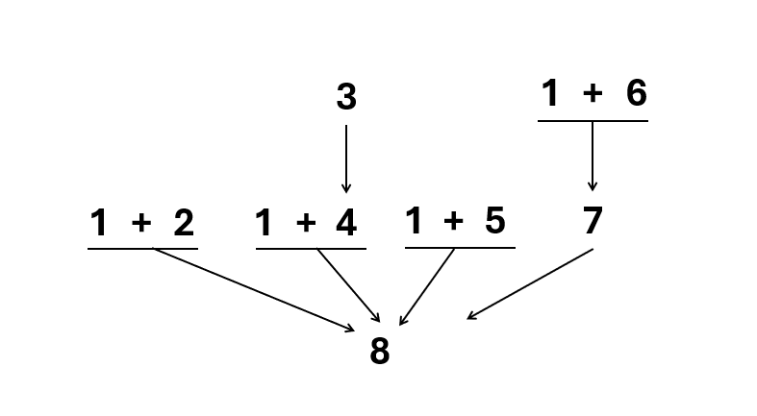
Assignment
(1) The intensity of heavy rain was concentrated over a short period.
(2) The old and degraded sewer system is inefficient at draining water.
(3) Waste carried by rainwater covers and blocks the drain inlets.
(4) Therefore, limit the ability to collect water into the sewer system.
(5) The road surface is locally sunken compared to the terrain of neighboring roads.
(6) Thu Duc market is a low-lying area, the difference between Thu Duc intersection and Thu Duc market is about 20m.
(7) So, the flow is very strong and the water flows back to Thu Duc market.
(8) Hence, Thu Duc City has 16 roads flooded due to heavy rain and the heaviest flooding is the area around Thu Duc market.
Notes:
Nguyen Minh An + BEBEIU22185
Vu Cao Bang + BEBEIU22014
Tran Thi Ngoc Diep + BEBEIU22183
Nguyen Do Quoc Hai + BEBEIU22032
Ngo Minh Khoi + BEBEIU22063
Nguyen Quoc Trung Nhan + BEBEIU22184
Vo Duc Trong + BEBEIU22155
Lam Hoang Xuan Yen + BEBEIU22272

Slide 3
Assignment
(1) The intensity of heavy rain was concentrated over a short period.
(2) The old and degraded sewer system is inefficient at draining water.
(3) Waste carried by rainwater covers and blocks the drain inlets.
(4) Therefore, limit the ability to collect water into the sewer system.
(5) The road surface is locally sunken compared to the terrain of neighboring roads.
(6) Thu Duc market is a low-lying area, the difference between Thu Duc intersection and Thu Duc market is about 20m.
(7) So, the flow is very strong and the water flows back to Thu Duc market.
(8) Hence, Thu Duc City has 16 roads flooded due to heavy rain and the heaviest flooding is the area around Thu Duc market.
Notes:
Nguyen Minh An + BEBEIU22185
Vu Cao Bang + BEBEIU22014
Tran Thi Ngoc Diep + BEBEIU22183
Nguyen Do Quoc Hai + BEBEIU22032
Ngo Minh Khoi + BEBEIU22063
Nguyen Quoc Trung Nhan + BEBEIU22184
Vo Duc Trong + BEBEIU22155
Lam Hoang Xuan Yen + BEBEIU22272

Slide 4
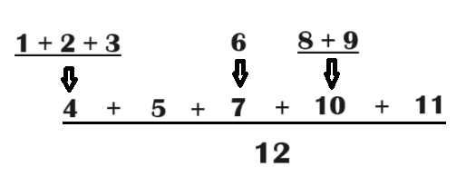
Assignment – Suggestion
The rain was too intense over a short period.
The old and degraded sewer system was inefficient at draining water.
Waste carried by rainwater covered and blocked the drainage inlets.
So, the old system's ability to collect water was severely limited.
Some roads in Thu Duc City are sunken compared to the neighboring roads.
The Thu Duc market is a low-lying area, with the difference between the Thu Duc intersection and the Thu Duc market of about 20m.
So, the flow was very strong and the water rushed back to the Thu Duc market.
The new drainage system has a capacity of 75.88mm of rain over 3 hours.
The rainwater on Dương Văn Cam St. (near the Thu Duc market) was measured 122,6mm in the short period.
So, this intense rain overflowed the capacity of the new drainage system.
Additionally, the flooding time (with the new drainage system in use) was reduced from 30 minutes or overnight to about 15 minutes.
Overall, the new drainage system is effective, but the intense concentration of heavy rain over a short period combined with several infrastructural and geographical factors led to significant flooding in 16 roads in Thu Duc City, particularly around the Thu Duc market.

Slide 5
CHAPTER 8
Evaluating Arguments
and
Refuting Arguments

Slide 6
WHERE HAVE WE BEEN SO FAR?
To know what critical thinking is and why we learn it.
To know basic elements of critical thinking and two patterns of reasoning
To evaluate deductive arguments by using tools
To recognize mistakes in reasoning
To analyze and standardize arguments
Chapter 1
Chapters 2 + 3
Chapters 9 + 10
Chapters 5 + 6
Chapter 7
To evaluate and strengthen arguments
Chapter 8

Slide 7
Part 1: Evaluating arguments

Slide 8
Part 1: Evaluating Arguments
Once an argument is summarized/standardized, you need to evaluate it so that you can decide whether or not to accept the conclusion.
Two main questions to evaluate:
Is the argument a good argument?
Are the premises acceptable?

Slide 9
What is NOT a good argument?
What a ‘good argument’ does NOT mean:
“agree with my views”
The conclusion is forceful or imposing.
“persuasive argument”
People can be persuasive by giving eloquent speech (which contains both rhetoric and fallacies).
“well-written/spoken”
Clarity, eloquence and organization can all occur in the presence of logical mistakes.

Slide 10
When is an argument ‘good’?
What a “good argument” does mean:
deductively sound
true conclusion following true premises
inductively cogent
probably true conclusion following true premises
A good argument embodies all the good qualities of critical thinking to have logic and make sense.

Slide 11
EIGHT STANDARDS OF GOOD ARGUMENTS
accuracy
precision
relevance
clarity
Good argument
consistency
logic
fairness
completeness

Slide 12
How to make an argument ‘good’?
Clear
Be understandable
Correct (accurate + precise + logical)
Use exact language and avoid equivocation
Relevant
Avoid off-topic and off-track material
Consistent
Avoid logical contradictions
Complete
Do not ignore facts relevant to the conclusion
Fair
Do not hastily dismiss objections

Slide 13
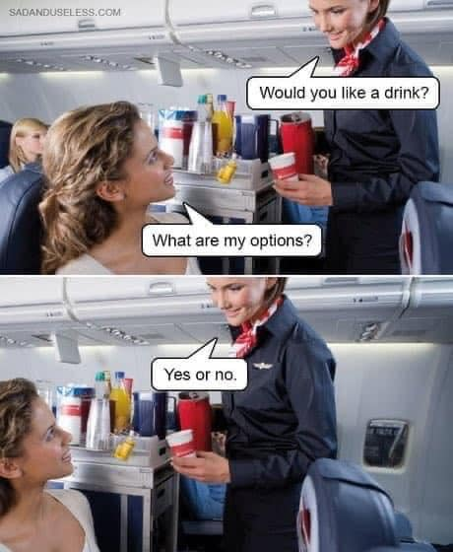
Which standard(s) is/are missing?
Missing precision
Missing relevance
Red herring

Slide 14
Part 2: Refuting arguments

Slide 15
Key concepts
Argue → Argumentation
To reason systematically in support of an idea
Refute → Refutation
To prove that an argument is incorrect; to directly weaken/attack an argument
Rebut → Rebuttal
To try to prove that an argument is incorrect, not strongly or directly attacking

Slide 16
Samples
Example – A simple argument:
Online learning is convenient for our class with some far-from campus students.
Claim/conclusion: Online learning is convenient for our class.
Evidence/premise: Some students in our class are far from the campus.
Refutation
Online learning is not quite convenient for our class. Only some students are far from campus while the near-campus students struggle in noisy settings.
Rebuttal
Online learning is not quite convenient for our class. Not all far-from-campus students in our class have good Internet access and devices.
→ Critical thinkers focus on refutations, not rebuttals.
Notes:
The refutation points out the fallacy of hasty generalization.
The rebuttal is weaker because it only attacks the idea of “convenient”, not “some far-from-campus students” but turns to another cause of inconvenience.

Slide 17
1. Reduce to the absurd
How to refute a claim
show that a statement is false by proving that it logically implies something that is clearly false or absurd (fallacious, unreasonable, illogical, or inappropriate)
Example:
Roommate: Absolutely all killing is wrong.
You: Is it wrong to eat any plants or animals?

Slide 18
2. Provide a counter-example
How to refute a claim (cont)
an example that proves that a general claim is false
Example:
A: All international academic institutions in Vietnam are private.
B: Wait a minute. HCMC International University is a public one.

Slide 19
How to refute arguments
Two ways to refute an argument:
1. Show that a premise - or a group of premises - is false or dubious (vague, doubtful).
2. Show that the conclusion does not follow from the premises.

Slide 20
1. Show false or dubious premises
Refuting deductive arguments
If a premise is critical to an argument, showing its falsehood will refute the argument.
(1) All presidents live in the White House.
(2) Bill Gates is a president.
So, (3) Bill Gates lives in the White House.
* We rarely have these arguments in real life.
false
true/false
Notes:
Missing completeness: All American presidents live in the White House.
Missing clarity: Bill Gates is a president. (business president? any organization’s president?)

Slide 21
Refuting inductive arguments
Children who have unsupervised access to the Internet may be exposed to pornographic and violent images.
Some sexual predators use the Internet to find and communicate with children.
Children have no ability to use a keyboard or mouse correctly.
So, children should not be allowed unsupervised access to the Internet.
→ For inductive arguments, showing ONE false premise is NOT sufficient to prove the conclusion is wrong.
false

Slide 22
→ Show insufficient premises for the conclusion
Refuting inductive arguments (cont)
Children should not be allowed free access to the Internet due to its physico-mental and social impacts. This is because when children have unsupervised access, they may be exposed to pornographic and violent images.
Critical question to refute: What is/are its social impact(s)?

Slide 23
Practice: Refute the argument
1. Show that the conclusion does not follow from the premises (cont)
Example 1:
Get high-speed Internet access by satellite. It’s fast, reliable, and won’t tie up your phone lines.
Ask questions to show these premises are insufficient.
What about costs (installation fee & high monthly payments)?
What about long-term contracts?

Slide 24
Practice: Refute the argument (cont)
2. Show that the conclusion does not follow the premises (cont)
Example 2:
I must ask my husband to buy me a Mercedes. Most of my rich friends drive luxury cars.
Ask questions to show these premises are irrelevant and/or insufficient.
Why do you have to follow your friends?
bandwagon
Is your husband rich?
weak analogy

Slide 25

Practice: Refute the loaded questions (cont)
Ask questions to show these loaded questions are false, or not totally relevant to the monk’s followers.
Do the followers include all farmers (in Vietnam)?
Do the followers include all textile workers (in Vietnam)?
Do the followers include all police (in Vietnam)?
Hasty generalization

Slide 26
Argument refutation & Argument essay

Slide 27
What does a critical thinker do?
Don’t accept an argument at face value.
→ Ask good questions to find out possible fallacies.
What evidence is accurate and relevant?
What evidence may the arguer illogically include or ignore?
Is the argument reasonable or does it need to improve?
Accept
Refute
Evaluate

Slide 28
5 types of deductive argument and common fallacies
1. Hypothetical syllogism
2. Categorical syllogism
3. Argument by elimination
4. Mathematical argument
5. Argument from definition
Fallacy of the Converse (affirming the consequent)
p→q q ∴p
Fallacy of the Inverse (denying the antecedent) p→q ~p ∴~q
invalid
invalid
Four terms included in the three-line arguments
Irrelevant/Insufficient evidence for elimination
Inaccurate, dubious vocabulary or grammar
Definitions lacking in eight standards of critical thinking

Slide 29
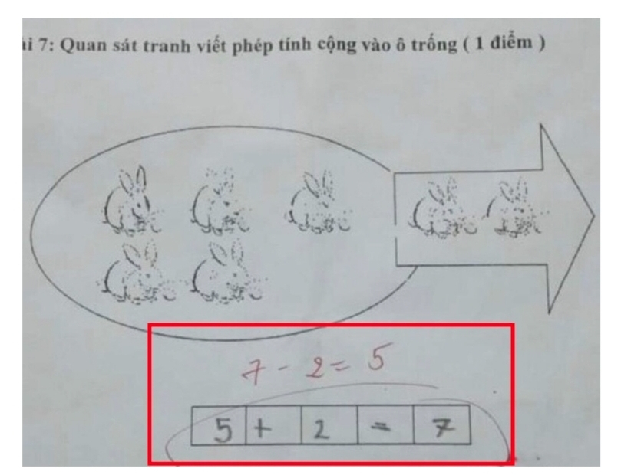
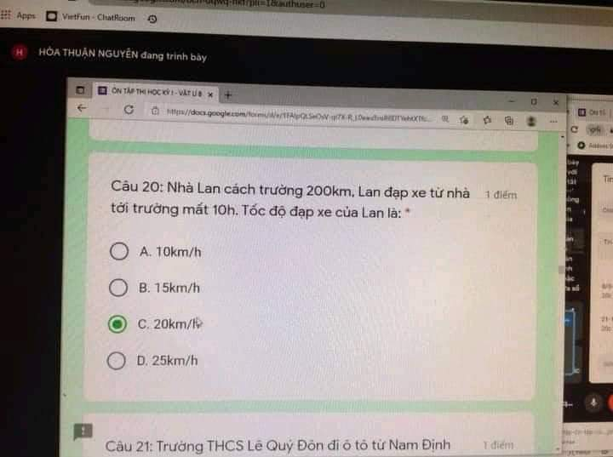
Common fallacies in mathematical arguments
Task: Observe the picture and write the addition in the boxes.
Task: Lan’s house is 200 km away from school. Lan cycles to school in 10 hours. So, Lan’s average speed is ____.

Slide 30

Common fallacies in arguments from definition
Definition: one hour = 100 seconds (inaccurate)
Darling,
There are 24 hours a day.
So, I save 1 second to breathe and the remaining 23h99s to miss you. ☺ ☺

Slide 31
6 types of inductive argument and common fallacies
Generalization argument
Predictive argument
Authority-based argument
Causal argument
Statistical argument
Analogy argument
What is true for a/some members is true for a group
Assuming things stay the same while time changes
Cite authorities/sources in inappropriate ways
Confusing cause-effect relationship
Relying on a potentially unrepresentative statistics
Drawing a weak analogy between two things

Slide 32
Activity: What fallacies do the arguments commit?
I couldn’t understand the lecture last week, so I’m sure today’s lesson will be impossible.
I have a recurring headache these weeks. Critical Thinking has caused my headache!
More than 100 students in our university have voted ‘No’ for the online final exam. Probably all students prefer an in-class exam.
A meal in the canteen costs as much as our home-made meal. Thus, it provides us with equivalent nutrition.
95% of students in our class support the removal of PE (Physical Education) out of the curriculum. Therefore, I’m sure my classmate Mary doesn’t like this subject.
Invest in bitcoins and other virtual currencies to get huge returns. Don’t you see some showbiz celebrities promote them on their pages?
Notes:
Assuming things stay the same while time changes
Confusing cause-effect relationship
What is true for a/some members is true for a group
Drawing a weak analogy between two things
Relying on a potentially unrepresentative statistics
Cite authorities/sources in inappropriate ways

Slide 33
Task: Analyze the argument
“The rate of crimes committed by teenagers in the country of Alta has steadily increased. This increase in teenage crime parallels the increase in violence shown on television. According to several national studies, even very young children who watch a great number of television shows featuring violent scenes display more violent behavior within their home environment than do children who do not watch violent shows. Furthermore, in a survey conducted by the Observer, over 90% of the respondents were parents who indicated that prime-time television - programs that are shown between 7 p.m. and 9 p.m. - should show less violence. Therefore, in order to lower the rate of teenage crime in Alta, television viewers should demand that television programmers reduce the amount of violence shown during prime time."

Slide 34
Task: Analyze the argument (cont)
↑ teen crime in Alta
↑ violence on TV
studies: very young children watching violence on TV→ ↑ violent @home
Observer survey: over 90% of parents: prime-time programs should have ↓violence
TV viewers should demand programmers to reduce violence shown during prime time
→ ↓ teen crime in Alta
1. ↑ teen crime is violent or non-violent?
2. Do teenagers watch these programs?
3. Who conduct(s) the studies?
4. Very young children = teenagers?
5. Which types of parents and how many were interviewed?
6. Who/What is the Observer?
7. Can viewers’ opinions alone change/influence TV programmers?
Notes:
Question 1: Red herring
Question 2: mere correlation
Question 3: Inappropriate appeal to authority
Question 4: Weak analogy/Red herring
Question 5: Hasty generalization (biased sample and small sample),
Question 6: Inappropriate appeal to authority
Question 7: Inappropriate appeal to authority

Slide 35
Sample refutation
Firstly, the author mentions the increasing crime rate committed by teenagers in Alta as one reason for his/her suggestion to reduce violent shows on TV during prime-time. However, the author may commit the fallacy of red herring when failing to clearly indicate if these crimes are violent or non-violent. If teenagers in Alta mostly commit non-violent wrongdoing like pickpocketing or shoplifting, the reduction of violent shows on TV does not solve the problem. Therefore, the author should clarify the nature of teenage crimes to make it more relevant to his/her conclusion.
Format:
- Summarize the text
- State the fallacy
- Give a reason
- Give an example
- Conclude/Improve

Slide 36
Sample refutation
In addition, the author offers a survey showing that 90% of the interviewed parents request prime-time television programs show less violence. However, the survey methods are not discussed - it is possible that the sample was improperly chosen to include academic parents that are very much opposed to television violence (biased sample). Additionally, it is possible that 90% of the parents interviewed belonged to a total number of 50 parents in a neighborhood of 300.000 residents (small sample). Therefore, it is hasty if the arguer bases his/her conclusion on that possibly unrepresentative survey result.
Format:
- Summarize the text
- State the fallacy
- Give a reason
- Give an example
- Conclude/Improve

Slide 37
Argument essay template
Introduction
Summarize the given argument.
State your point of view (agree or disagree with the argument).
Body paragraphs 2 - 4
Summarize the fallacious text.
Refute it with your own claim (name the fallacy).
Give reason(s) and example(s) to support your claim.
Wrap up with 1 concluding sentence (optional).
Conclusion
Restate your point of view.
Show how to strengthen the argument.

Slide 38
SAMPLE INTRODUCTION
The author states that the rate of teenage crime in the country of Alta has increased along with the increase in violence shown on television. In addition, the author indicates several national surveys that show young children watching violent television programs are more prone to violence than children who do not. The author also says that a survey indicated that 90% of parents responding said that prime-time programs should show less violence. These (premises) take the author to the conclusion that to lower the rate of teenage crime in Alta, television watchers should ask for a reduction in violence shown during prime time. This argument suffers from several critical fallacies.
Notes:
The reporting verbs must be in the present tense.

Slide 39
SAMPLE BODY PARAGRAPH 1
Firstly, the author equates the rate of increase in teenage crime in Alta to the increase in violence shown on television but gives no causal linkage other than the similar time periods. This may be just a mere correlation. In addition, the author makes no distinction between types of crimes - whether they are violent or nonviolent crimes by teenagers - and (s)he oversimplifies the cause of teenage crimes, that is, violent shows only. In fact, there are several possible causes of the increase in teen crimes. For example, maybe the police are now doing a better job of catching teenage criminals than they were before. One more reason for the increase in teenage crime rate is simply an decrease in the overall population, so that the same teenage criminals seem to account for a higher rate than it was before. Without ruling out these and other causes, the argument fails to convince by showing no causal linkage between television violence and teenage crime.
Notes:
First, summarize a fallacious text you want to refute.
Second, give your refutation (name the fallacies)
Third, give reason(s) and details/examples
Optional: Concluding sentence

Slide 40
SAMPLE BODY PARAGRAPH 2
Secondly, the author mentions some national studies that show that young children that watch violent programs show more violent behavior at home than children who do not watch such programs. This argument fails on two levels - one by assuming that very young children and teenagers are equally affected by television programs (weak analogy); and two by again assuming that there is some type of cause-effect relationship between children’s bad behavior at home and teenage crime in society (questionable cause). Young children and teenagers are not the same in their awareness levels, since nurture at home and discipline or order in society may influence children and teenagers in different ways. As such, it should not be assumed that more violent behavior within the home leads to crimes in society as these children grow into teenagers.
Notes:
First, summarize a fallacious text you want to refute.
Second, give your refutation (name the fallacies)
Third, give reason(s) and details/examples
Optional: Concluding sentence

Slide 41
SAMPLE BODY PARAGRAPH 3
Thirdly, the author offers a survey showing that 90% of the respondents were parents claiming that prime time television programs should show less violence. However, the survey methods are not discussed - it is possible that the sample was improperly chosen to include academic parents that are very much opposed to television violence (biased sample). Additionally, it is possible that 90% of the parents interviewed belonged to a total number of 50 parents in a neighborhood of 300.000 residents (small sample). Therefore, it is hasty if the arguer bases his/her conclusion on that possibly unrepresentative survey result.
Notes:
First, summarize a fallacious text you want to refute.
Second, give your refutation (name the fallacies)
Third, give reason(s) and details/examples
Optional: Concluding sentence

Slide 42
SAMPLE CONCLUSION
In conclusion, it cannot be denied that the author has good intention to build a healthier community, but his/her argument is not built on solid evidence. To strengthen his/her argument, the author needs to show some direct causal linkage between television violence and teen crime rather than making vague and unsupported comparisons to show a link. When more proof is given, parents and authorities will agree on a change for the benefits of their young television viewers.
Notes:
Suggest how to strengthen the argument

Slide 43
Practice: Analyze the argument
All mothers should stay home with their young kids. It would promote closer family ties, and studies show that children with stay-at-home moms do better in school, have higher self-respect, and are less likely to get involved with drugs or commit crimes.

Slide 44
Analysis
Premises:
1. Stay-home moms promote better ties with kids
2. Studies show that children with stay-at-home moms:
- do better in school
- have higher self-esteem
- are less likely to get involved with drugs/ crimes
Conclusion:
All mothers should stay home with their young kids.

Slide 45
Analysis (cont)
Fallacies:
1. Questionable cause: Stay-home moms may put more pressure on kids -> worse relationships
2. Biased sample: Studies may have had surveys on good moms only.
3. Questionable cause: Kids may learn good things from school, not from moms
4. Red herring: young kids and children who can get involved with drugs or crimes are different groups.
5. Hasty generalization: Not all moms, including single moms or poor moms, can stay home with their kids.

Slide 46
Activity: Analyze the argument
Notes:
https://vietcetera.com/vn/no-o-no-cua-cho-khong-bang-cach-cho
https://u.osu.edu/introhumanitiesonline/2020/04/06/poverty-porn/

Slide 47
GROUP PARTICIPATION SCORE IMPROVEMENT
Find any (controversial) excerpts of newspaper articles/books, a public speech, etc., find the fallacies and refute them. (1 bonus point for a reasonable refuting paragraph).
Format:
- Summarize the text
- State the fallacy
- Give a reason
- Give an example
- Conclude/Improve
The writer/speaker claims that…
However, this statement commits the fallacy of…
This is because….
For instance,
Therefore, the writer/speaker should…
Notes:
First, summarize a fallacious text you want to refute.
Second, give your refutation (name the fallacies)
Third, give reason(s) and details/examples
Optional: Concluding sentence

Slide 48

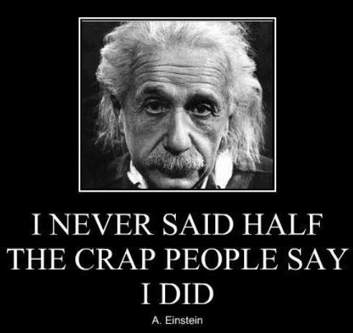

Some suggestions
https://goodshepherdshorehambeach.org.uk/just-for-fun/a-famous-debate/

Slide 49
If your Participation score is over 100, the accumulated points will go to the final project.
Link to submit:
https://forms.gle/L9nDNQfSvV4QSHRT8
Deadline: Before the exam date

Slide 50
Attendance check

Slide 51
THANK YOU

